Slide 1
Introducing the IETF
Geoff Huston AM
APNIC

Slide 2
I’ll probably talk about:
Some Background - The Rise of Open Networking
The emergence of the IETF
Kings, Voting and Running Code
Today’s IETF
And a few opinions!

Slide 3
About me and the IETF
First RFC encounter: Implemented RFC 850 on Vax/VMS in 1985
First IETF meeting: November 1989
RFCs (co)authored: 44
IETF Working Group Chair: TACIT, SHIM6, GROW, SIDR
IAB Member: 1999 – 2005 (Executive Director 2001 – 2005)

Slide 4
In the Beginning…
Work on digital data networking is probably as old as the teletype machine of the 1940’s
Early work in dedicated networking probably starts with the SAGE in the late 1950s
  Air Force program to build a continental air defence system
Commercial networks appeared in the 1960s
  Such as SABRE for airlines
  Vendor-specific platforms leasing digital circuits from the phone company
Packet switching also emerged in the 1960s
  Parallel work in US, UK and France on the use of packets rather than time divisions to share a common transmission system
  Research project in the US supported by ARPA to develop communications protocols that were an overlay across a packet switching network substrate

Slide 5
Emergence of the Internet
Vint Cerf and Bob Kahn published a paper on the design of the Internet Protocol in May 1974
This was envisaged as a “network of networks” overlay where packets were passed through a sequence of networks to reach their intended destination:
  Datagram architecture as the Lowest Common Denominator
  Adaptive Fragmentation to bypass the MTU problem
  End-to-End architecture to push reliability and performance to the edge

Slide 6
Next Steps
Three events occurred at about the same time to push the Internet into prominence:
  Digital Equipment gained market share through the development of the “mini computer” which changed the computing environment from a cluster of peripherals around a mainframe to a diverse collection of computers sharing users and (hopefully) computation tasks!
  The divestiture of AT&T released the Unix operating system to universities as an open source free-to-use tool . There was at last a viable alternative to vendor-proprietary computing and networking technology
  UC’s Berkely Software was contracted by ARPA to code the Internet Protocol suite and this was released as a public open source bundle without copyright constraints

Slide 7
OSI
There was a parallel effort to develop open networking tools that became known as the Open Systems Interconnection protocol suite OSI)
This had strong backing from the telco sector as well as backing from some computer vendors
It’s work was focussed in Europe where it was seen as the next step for the (telco) X.25 packet switched service
The problem was that it had not gathered much support in the US, and it was very incomplete work – in contrast with the IP protocol suite that was now in widespread use in parts of the the academic and research world.

Slide 8
The IETF
Was formed in acknowledgement that the US government agencies were not going to be the sole funding agency for the further development of the Internet. The Internet effort needed to broaden its support base and involve other researchers and industry to sustain it
The interests of the folk involved in the effort had much in common - in that they wanted cheap, fully functional, and a common open technology that could work at scale. They were not interested in vendor proprietary approaches

Slide 9
The Tao of the IETF
Much has been borrowed from the research community:
We participate as individuals, not corporates
Documents are created to individual authors and editors, not anonymous committee
Its open in almost every possible way
Nothing is ever finished
  Everything is a work in progress
  Anything can be revised if a better approach comes along
And there is no voting

Slide 10
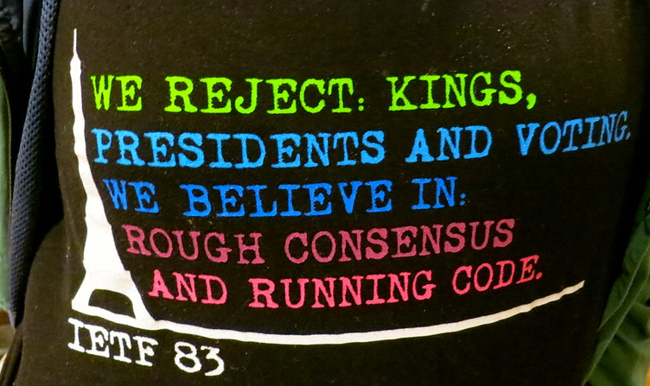
Tristian Nitot, https://www.flickr.com/photos/nitot/8294413830

Slide 11
The Role of an IETF Standard Specification
An IETF standard specification is meant to provide sufficient guidance to programmers such that any implementation produced in accordance with this specification will fully interoperate with any other implementation built from the same specification
An IETF specification is intended to be ‘fit for purpose’. Its not meant to solve every problem, but it is intended to solve the problem it was intended to solve and not cause more problems for other
An IETF specification is intended to describe open technology. If there are encumbered alternatives then the IETF would tend to use the option that was fully open. Otherwise the IETF will tend to use technologies that are generally freely available on non-discriminatory terms

Slide 12
Today’s IETF
The effort is divided in many ways:
  The IETF LLC provides a corporate “home” for the various IETF activities – it is a “single member disregarded entity of the Internet Society”
  The IETF Trust, which provides a point for the licence of use of IETF material
  The Internet Architecture Board – a committee that has some oversight roles, liaison roles, procedural roles and some advisory roles. In their spare time they dabble in architectural topics
  The Internet Engineering Steering Group and Areas – the work of the IETF is divided into areas, and each area is headed by 2 Area Directors. These Area Directors are responsible for the overall technical management of the IETF activities and the operation of the standards process
  Working Groups – do the work!

Slide 13
And there’s the IRTF
The Internet can be looked at as an unfinished piece of work
We are still learning how to do this well, at scale, in a secure manner, and without blowing it all up!
The IETF has always engaged with the research community to provide us with insight as to what we could be doing and why – this engagement is structured into the Internet Research Task Force
The IRTF has a number of Research Groups
These groups may publish their thinking, but it is really iup to the IETF to take up any outcomes from these groups and map then into standard specifications

Slide 14
The Role of Standards
In a command economy goods are produced on order and in accordance with the orchestrator of the activity
In a deregulated economy goods are produced in hope that others will find them to be of value
  The orchestrator of deregulated market is the market itself
  Standard specifications are intended to support such a deregulated market by providing a neutral (in independent) benchmark that will allow producer and consumer to mutually assure compatability

Slide 15
IETF Failures
Attempting to steer the course of the Internet through standards actions
  NATs, IPv6, Security
Losing touch with the research community
Losing touch with current network needs and focussing on past requirements

Slide 16
IETF Successes
Open to individuals to participate by contribution
Debate the idea not the person
Your future leadership are already in today’s working groups
Adapt and change to reflect a changing world
Perfection is impossible in this space – try to aim for “useful”, or even “not harmful”
Be humble – things will change and “right” today may well be “wrong” tomorrow

Slide 17
IETF Challenges
Renewal
Relevance
Sustainability

Slide 18
Thank You !

