Slide 1
Measuring the Effectiveness of Route Origin Validation Filtering via Drop Invalids from the perspective of the End User using a Technique of Broad Scale Reachability Measurement
Geoff Huston, Joao Damas
APNIC Labs

Slide 2
Measuring RPKI
Geoff Huston, Joao Damas
APNIC

Slide 3
Measuring RPKI
Route Origin Validation Filtering!
Geoff Huston, Joao Damas
APNIC

Slide 4

Routing Security
What’s “the objective” of routing security?

Slide 5
Routing Security
What’s “the objective” of routing security?
  Protect the routing system from all forms of operator mishaps?
  Protect the routing system from some forms of operator mishaps?
  Protect the routing system from all hostile attacks?
  Protect the routing system from some hostile attacks?
  Prevent the routing of bogus address prefixes?
  Prevent the use of bogus AS’s in the routing system?
  Prevent all forms of synthetic routes from being injected into the routing system?
  Prevent unauthorised route withdrawal?
  Protect users from being directed along bogus routing paths?

Slide 6
Let’s not be too ambitious!
Enforcing rules to ensure that the routes carried in BGP are both protocol-wise accurate and policy-wise accurate is well beyond the capabilities of BGP and viable BGP control mechanisms *
Route Origin Validation is designed to prevent BGP speakers from learning and preferring routes that are not authorised by the prefix holder
The intent of not preferring unauthorised routes is to prevent users’ traffic from being steered along these bogus routes
* BGP is not a deterministic protocol, but more of a negotiation protocol that attempts to find meta-stable ‘solutions to importer / export policy preferences simultaneously. Where the policies are incompatible the BGP “solution” is not necessarily reached deterministically and different outcomes will be seen at different times – see “BGP Wedgies” for an illustration of this form of indeterminism

Slide 7
Routing Security
What’s “the objective” of routing security?
  Protect the routing system from all forms of operator mishaps?
  Protect the routing system from some forms of operator mishaps?
  Protect the routing system from all hostile attacks?
  Protect the routing system from some hostile attacks?
  Prevent the routing of bogus address prefixes?
  Prevent the use of bogus AS’s in the routing system?
  Prevent all forms of synthetic routes from being injected into the routing system?
  Prevent unauthorised route withdrawal?
  Protect users from being directed along bogus routing paths!

Slide 8

Our Objective
To measure the “impact” of invalid route filtering on users
The question we want to answer here is user-centric:
  What proportion of users can’t reach a destination when the destination route is invalid according to ROV?

Slide 9
Production vs Consumption
There are two aspects to this framework:
Generating ROAs to describe the intended origination of prefixes
Looking for those networks that will admit and propagate invalid routes
  i.e.: those networks that are not performing some for of “drop invalid” filtering on BGP advertisements

Slide 10
Populating the RPKI - ROAs
284,000 ROAs are published today

Slide 11
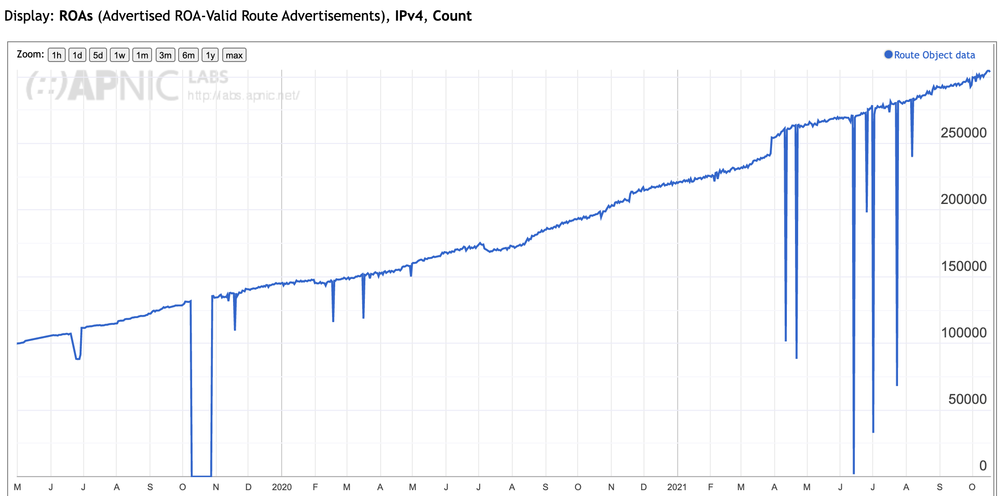
Applying ROAs to Routes
IPv4 Routes that are ”covered” by a ROA

Slide 12
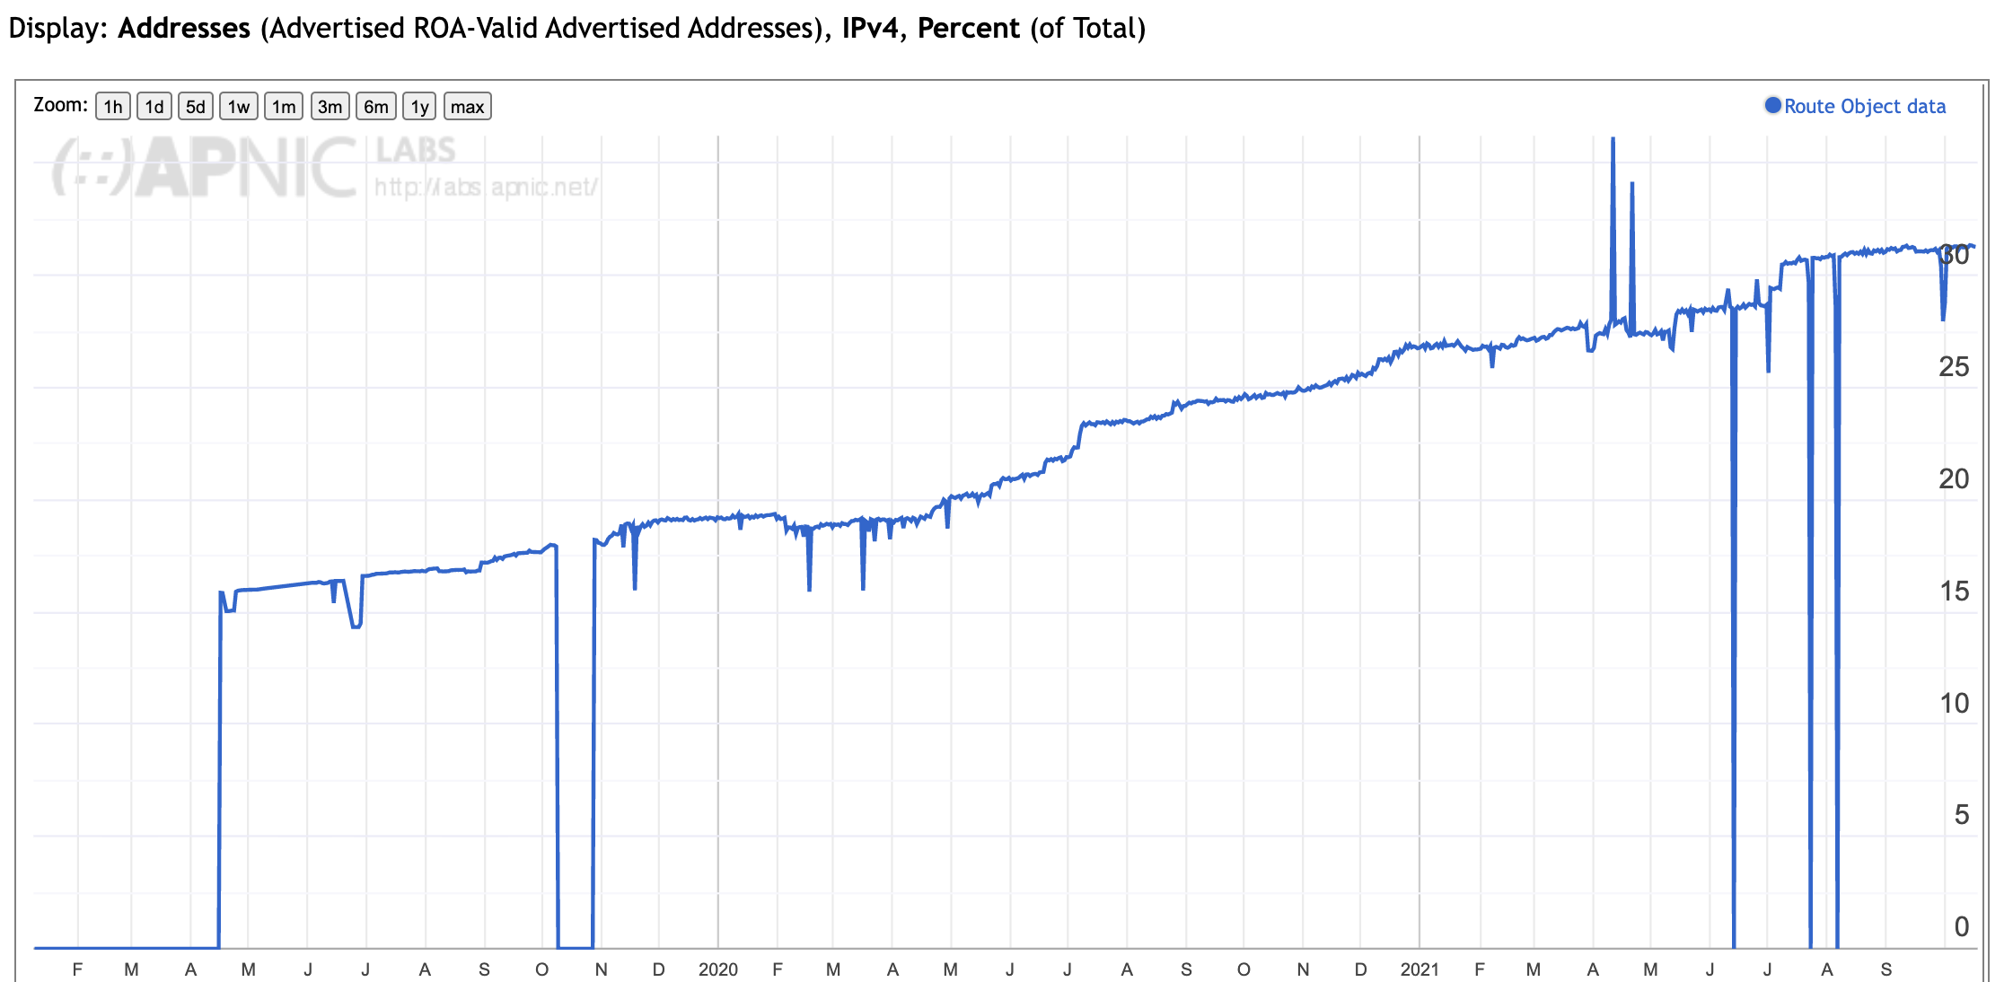
Applying ROAs to Routes
IPv4 Addresses that are ”covered” by a ROA

Slide 13
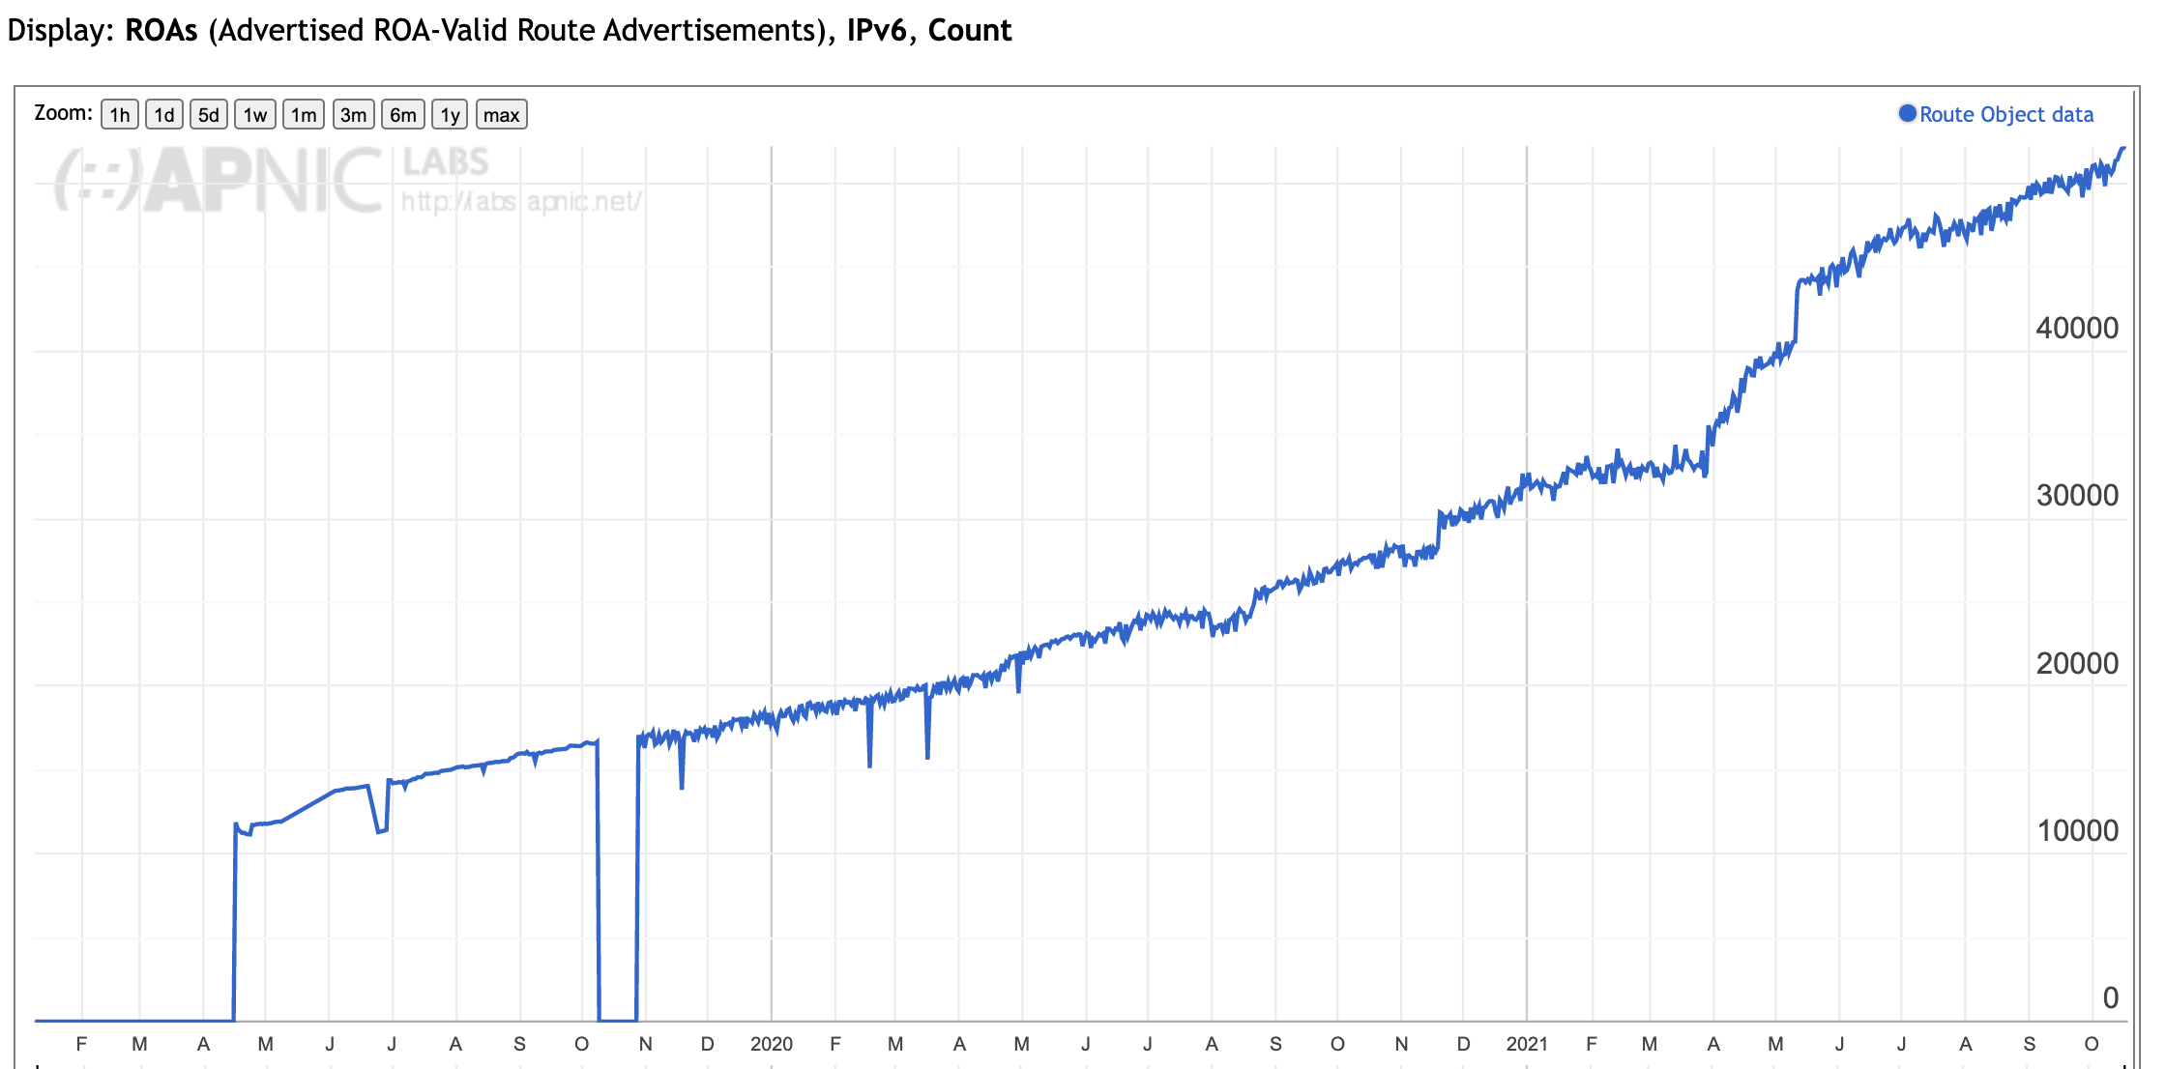
Applying ROAs to Routes
IPv6 Routes that are ”covered” by a ROA

Slide 14
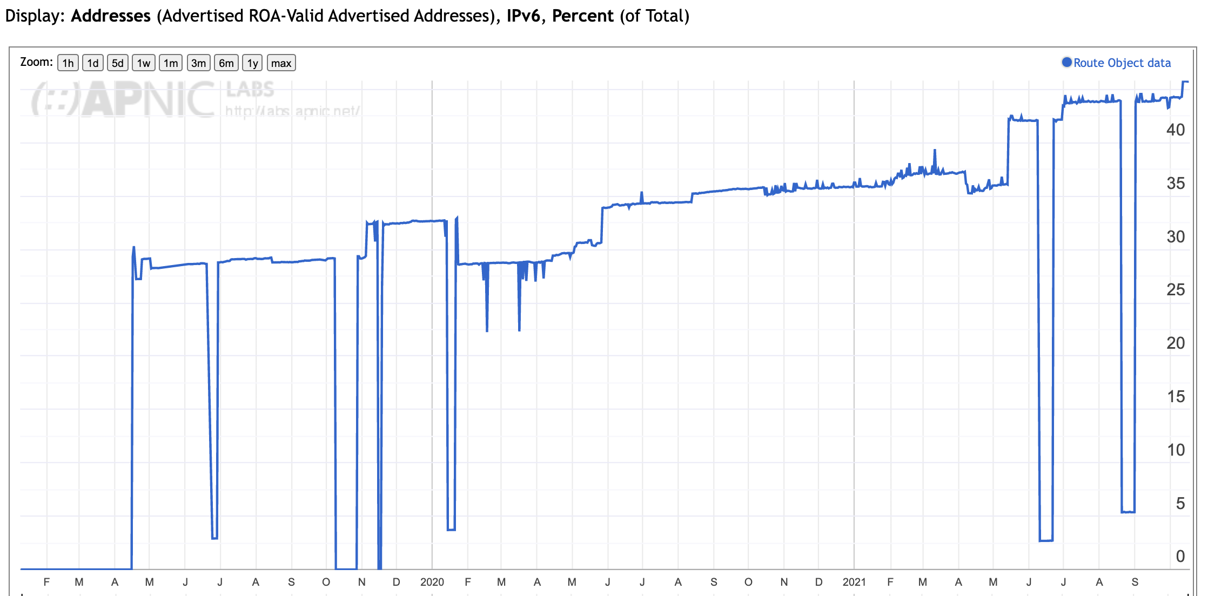
Applying ROAs to Routes
IPv6 Addresses that are ”covered” by a ROA

Slide 15
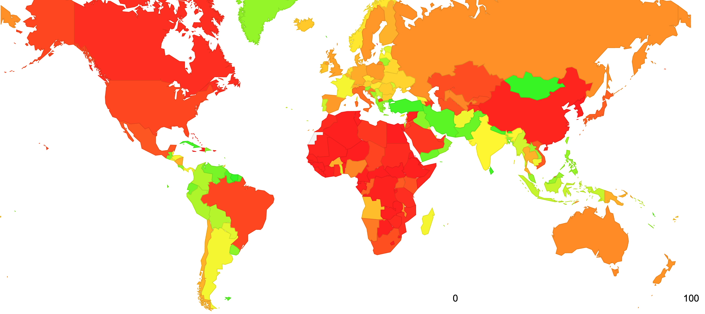
RoA coverage by Economy

Slide 16
Production vs Consumption
The next question is: Who is using these ROAs to determine whether to accept routes (or not!)

Slide 17
RPKI Clients
How many clients regularly maintain a local cache of the entire RPKI product set ?

Slide 18
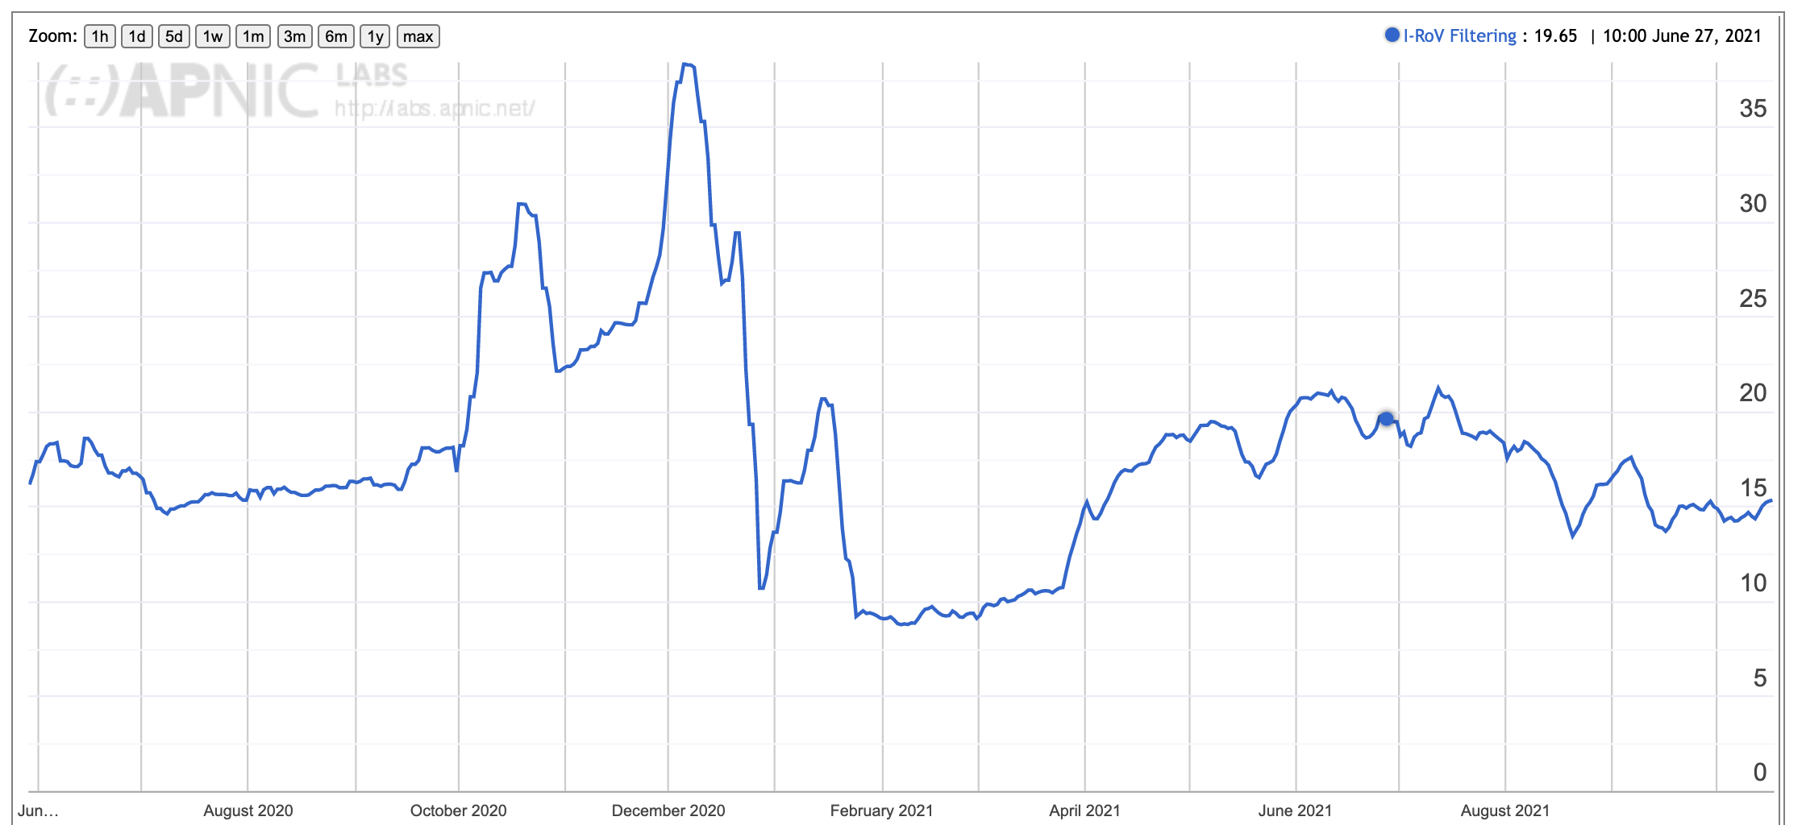
Filtering RoV routes
What proportion of users are behind networks that filter ROV-invalid routes?

Slide 19
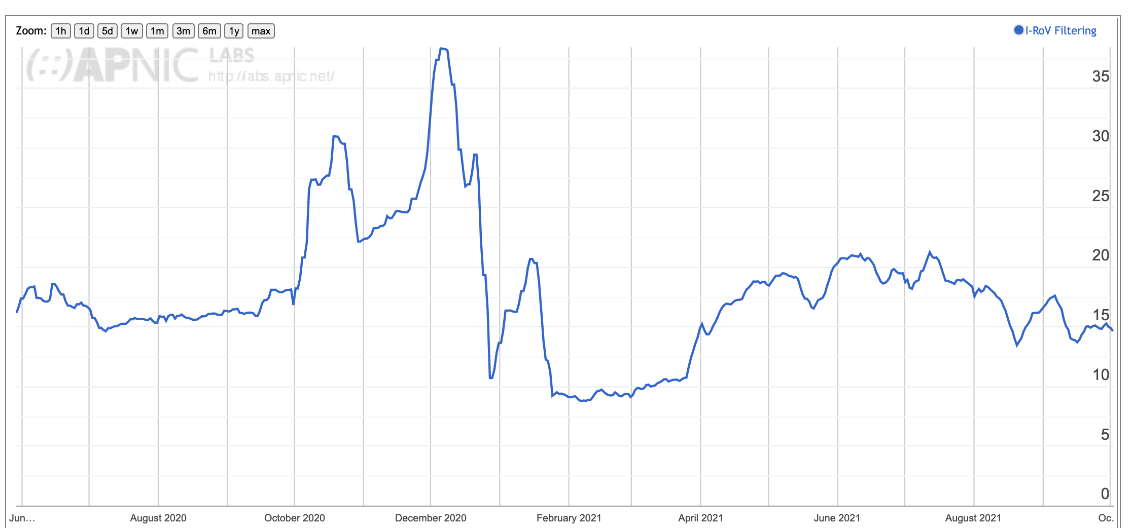
RoV Filtering
This is an unexpected result
Only some 15% of users cannot reach a prefix when it is advertised using a ROV-invalid prefix
And this has been constant measurement for the past ~12 months
It seems that few edge networks have been performing ROV dropping
And similarly few transit networks have taken up ROV-dropping
And there is sufficient diversity in the inter-AS topology that even if some paths are filtered out, alternate transit paths sill provide access

Slide 20
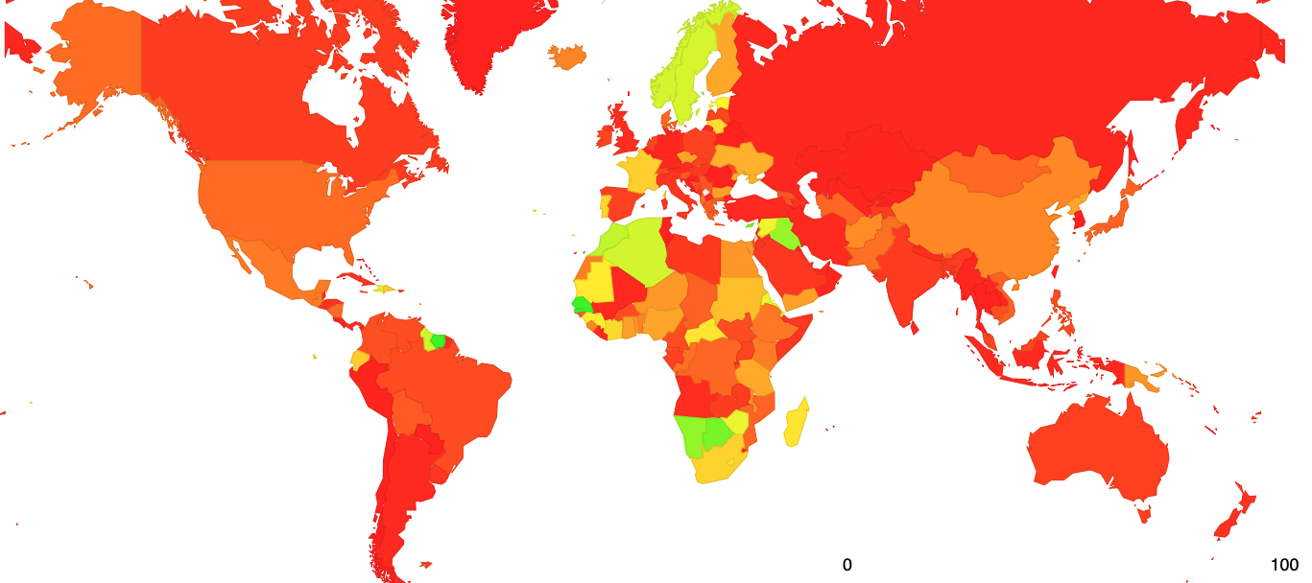
Results: User Impact of ROV filtering – Jul 2020
https://stats.labs.apnic.net/rpki

Slide 21
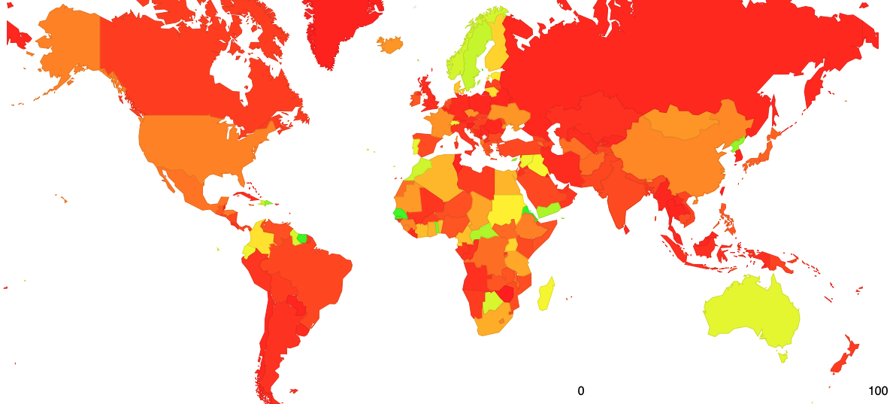
Results: User Impact of ROV filtering – Oct 2020
https://stats.labs.apnic.net/rpki

Slide 22
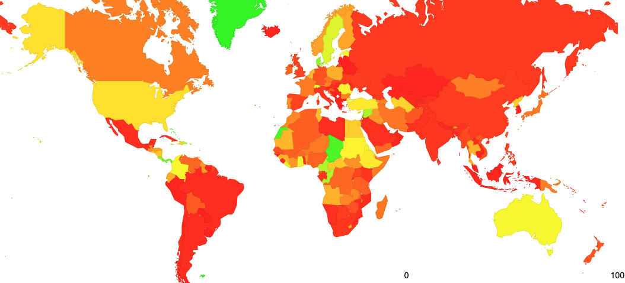
Results: User Impact of ROV filtering – June 2021
https://stats.labs.apnic.net/rpki

Slide 23
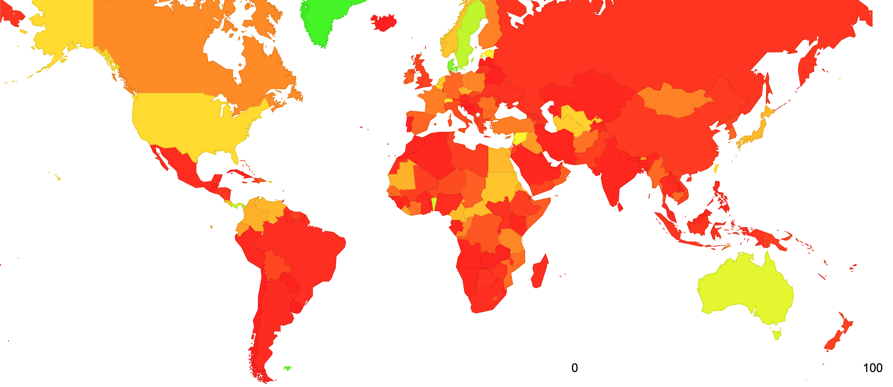
Results: User Impact of ROV filtering – October 2021

Slide 24
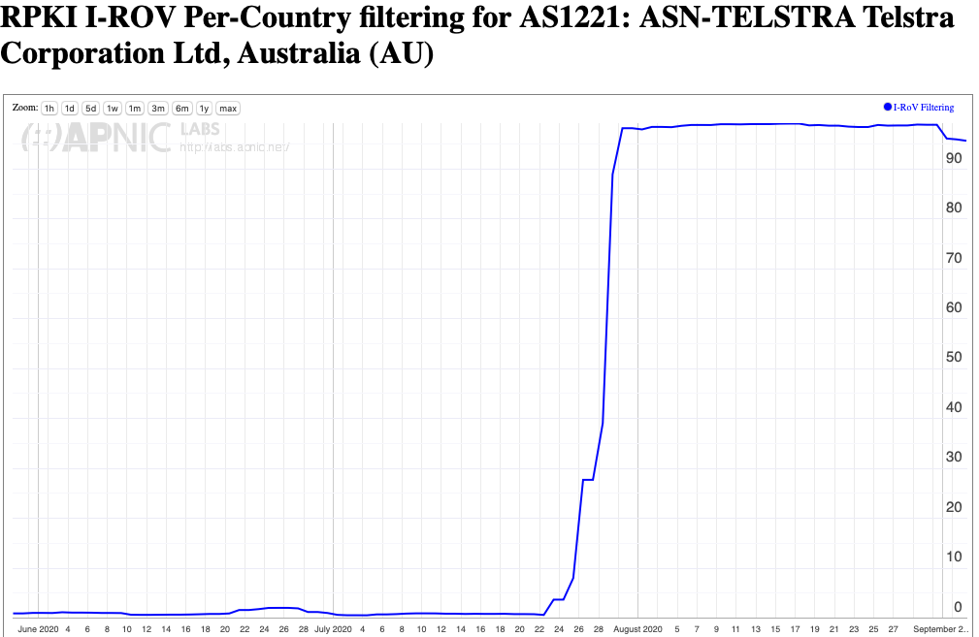
Turning on Drop Invalid Filtering

Slide 25
Many operators are reluctant to turn on ROV Filtering
It appears that generating ROAs for advertised routes has had a good uptake across network operators
However turning on RoV drop invalid filtering has had had a slower update
For example, Mongolia has an almost complete set of ROAs for advertised routes, but far less in terms of ROV drop invalid update

Slide 26
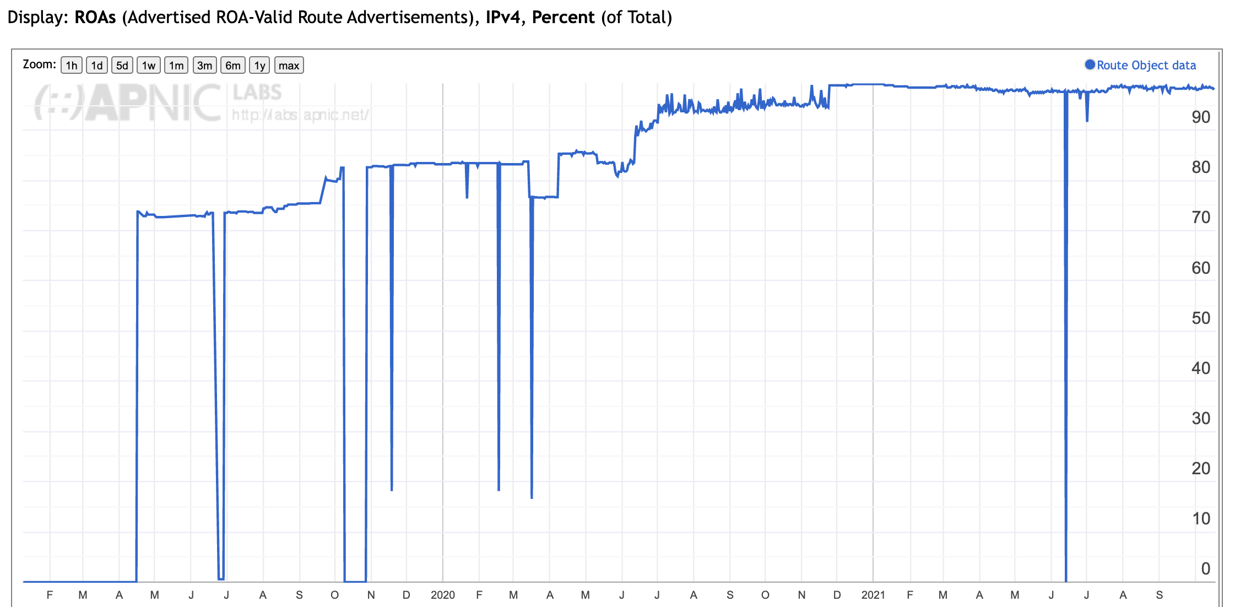
ROAs for networks in Mongolia

Slide 27
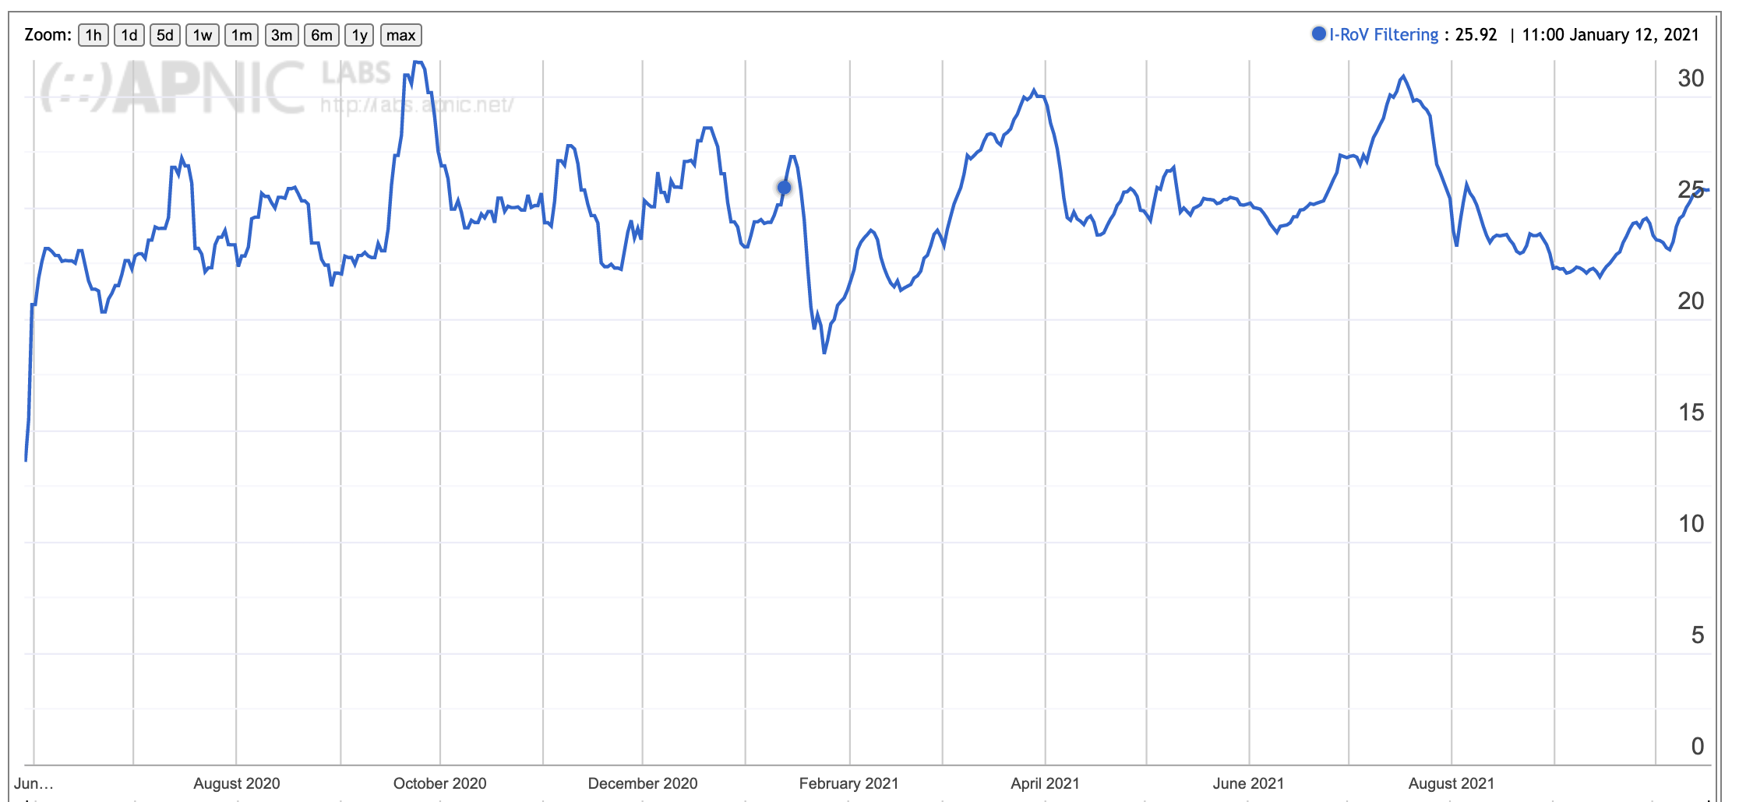
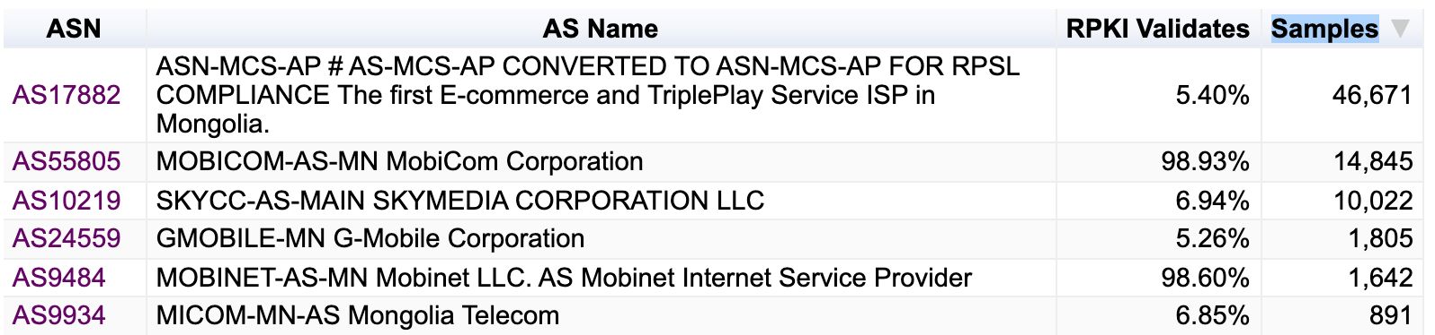
ROV for networks in Mongolia

Slide 28
Questions we might want to think about
Stub vs Transit
Is it necessary for every AS to operate RPKI ROV infrastructure and filter invalid routes?
If not, what’s the minimal set of filtering networks that could provide similar levels of filtering for the Internet as a whole
What’s the marginal benefit of stub AS performing RPKI ROV filtering?

Slide 29
Questions we might want to think about (2)
Ingress vs Egress
Should a stub AS RPKI only RoV filter its own announcements?
Should every AS filter their own announcements?
What’s more important: Protecting others who DON’T RoV filter from your operational mishaps or protecting yourself from the mishaps of others?
Does Partial Adoption of ROV filtering change your answer?

Slide 30
Questions we might want to think about (3)
Prefix attestations vs AS attestations
Should an AS be able to enumerate ALL of its originations in a AS-signed attestation?

Slide 31
Questions we might want to think about (4)
When and how will we protect the AS Path?
What is going in with the ASPA drafts in the IETF?
Is anyone experimenting with ASPA yet?
What is the benefit of Origination protection without AS Path protection?

Slide 32
What are we trying to achieve here?
If this is a routing protection measure then what are you trying to protect? From whom? From what threat?
If this is guard against operational errors then don’t forget that operational mishaps are endlessly varied, and we can’t foresee all possible causes of routing accidents!
If this is a user protection measure then the issue of route filtering is an issue for transit providers, not stub networks
  A stub network should generate ROAs for its routes, but there is far less of an incentive to perform RoV invalid filtering if the stub’s upstreams / IXs are already performing this filtering
  Is it more important for IXs and Transits to perform drop-invalids than for stubs?

Slide 33
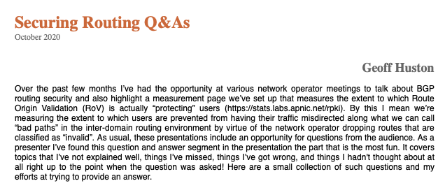
Thanks!
Questions?
See https://www.potaroo.net/ispcol/2020-10/rpkiqa.html

