Slide 1
Cyber Governance

Slide 2
What is “Cyber Governance”?
I have absolutely no idea!
If we are talking about “governance” as an imposition framework (legislated and/or regulated constraint imposed on actors) then very little of that exists in today’s Internet
What mechanisms “govern” today’s Internet?
How did we get here?

Slide 3
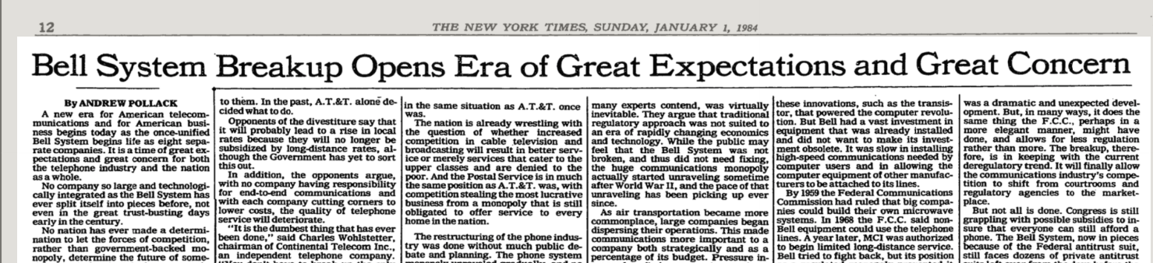
Telco Deregulation
The 1980’s saw massive changes in the public telecommunications sector
  The forced breakup of the US Bell system in 1982 started a wave of reforms for the nationalised telco sector

Slide 4

Market Disciplines as Governance
Public Sector-operated services were passed into the private sector
  The sector was opened up to competition in the belief that competition would force greater efficiencies and lower prices from the sector
  It was all about competition in telephony creating benefits for consumers

Slide 5
Transformation
As it turned out it was not about competition in telephony
  It was about competition in technology innovation
The combination of technology innovation and deregulation placed the entire sector (and its revenues) up for grabs
  Venture capital entered the market to accelerate this disruption
These changes required the incumbents to transform themselves at a scale and speed that was beyond the capability of many
The resultant marketplace was shaped by a continual stream of innovative pressures and disruptions
This is unsustainable long term

Slide 6
Market Distortions
Markets can fail in many ways:
  Emerging monopolies, manipulation and distortions, selective advantage, corruption
The results of market failures are much the same:
  Inefficiencies in supply of goods and services

Slide 7
Today’s Internet
A small clique of enterprises totally dominate the Internet
What the problem here?
  Are they too big?
  Too exploitative of their workers?
  Extracting monopoly rentals?
  Ignoring consumer preferences?

Slide 8
But it’s want we want
These enterprises are highly efficient operators in the new economy of surveillance capitalism
They have the ability to customise a solution to a market of a single consumer and still bring economies of scale to that market
As consumers we use their services because they are tailored for us!
But is this what we really want?

Slide 9

Is this what we want?

Slide 10
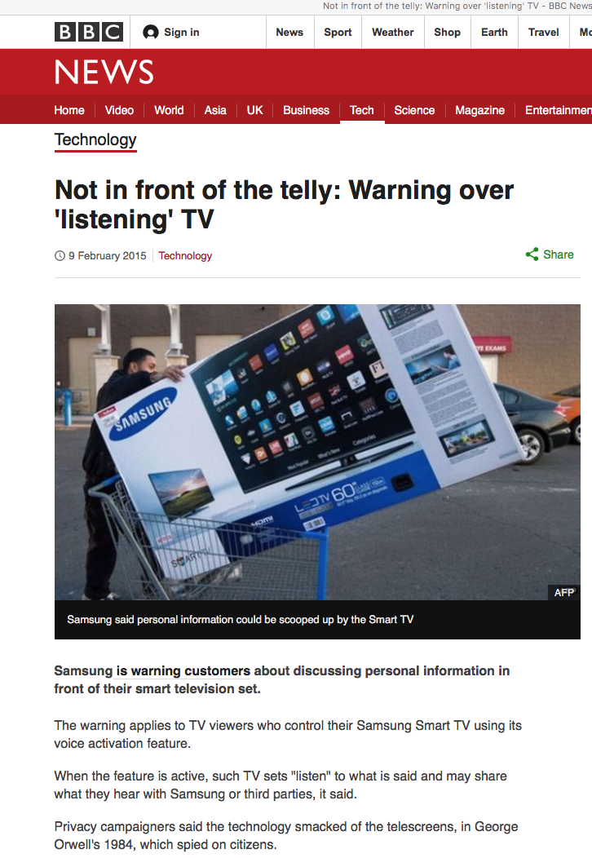
Is this what we want?

Slide 11
What we might want
If this situation calls for some public sector response then perhaps the thrust of any such response should focus on the consumer rather than the dynamics of the market

Slide 12
Some Questions
Perhaps an effective regulatory regime should be able to provide clear answers to these questions:
  Who owns my personal profile data?
  Where is it stored?
  What regulatory regime protects it?
  Should I be informed when my profile is sold?
  Do I have an informed valuation of my personal profile?
  Who is at fault if my personal data is leaked?

Slide 13
Where are we?
Its clear we’re not in Kansas any more
And whatever the Internet may be, it’s not a telephone network for computers

Slide 14
Where are we?
We are now communicating with a computer-mediated environment rather than with each other
The network itself is largely incidental to this evolving story, and this is not really about the Internet any more
It’s about a set of revolutionary social changes on a par with the industrial revolution that have been triggered by abundant computing, storage and comms

Slide 15
Maybe its more than this
In a world of abundant content what do we choose to view?
What do we choose to believe?
Search becomes the arbiter of content selection and assumes a level of ultimate importance in this world
What’s the outcome of search being dominated by a single entity?

Slide 16
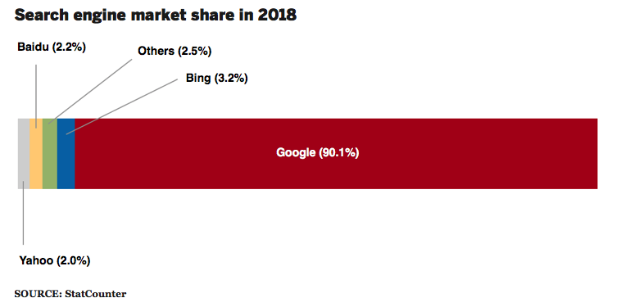
Is it about what we want or is this more about what we think?
Share of search in US market

Slide 17
Where does all this head?
For our society this market-driven digitisation of our environment has the potential to be incredibly empowering or incredibly threatening
Or both at the same time!

